Slide 1
Microsoft Teams
A hub for teamwork in Office 365
Notes:
Objective: Introduce Microsoft Teams as the hub for teamwork in Office 365 in Education AND new Partner opportunity
<introduce yourself>

Slide 2
Agenda
What is Microsoft Teams?
Microsoft Teams Demo
Education Apps in Microsoft Teams
Opportunity
Next Steps
Notes:
Objective: Set the agenda
We have two major halves for our agenda. For the first half, I will give you an overview and a demo of Teams and for the second half, we will discuss ideas and some designs on how your experience could look like in Teams.

Slide 3




The Hub For Teamwork for Office 365 in Education
Conversations, video & voice
Integrated with Office 365 apps
Customizable & extensible
Enterprise security, compliance & manageability
Communicate in the moment and keep everyone in the know.
Give your team built-in access to applications they need in Office 365.
Tailor your workspace to include apps and services for the team and organization.
Get the enterprise-level security and compliance features you expect from Office 365.
Notes:
Slide Objective
Introduce Microsoft Teams
Talking points:
Microsoft Teams is the hub for teamwork for Office 365 in Education.
Teams help students and teachers engage both inside and outside the classroom through conversations, video, voice and by collaborating around their everyday applications in a single, central hub.
We understand that not every single classroom is the same. So we have given teachers and students the ability to customize their teams and make it their own, while ensuring and upholding all our commitments to protect and safeguard their privacy, conversations and data.
Lastly, we believe that Teams is an exciting platform for Educational partners like yourself to bring in your powerful experiences into the classroom to help teachers and students achieve more.
Now let's see what Teams looks like for a 7th Grade History teacher.

Slide 4
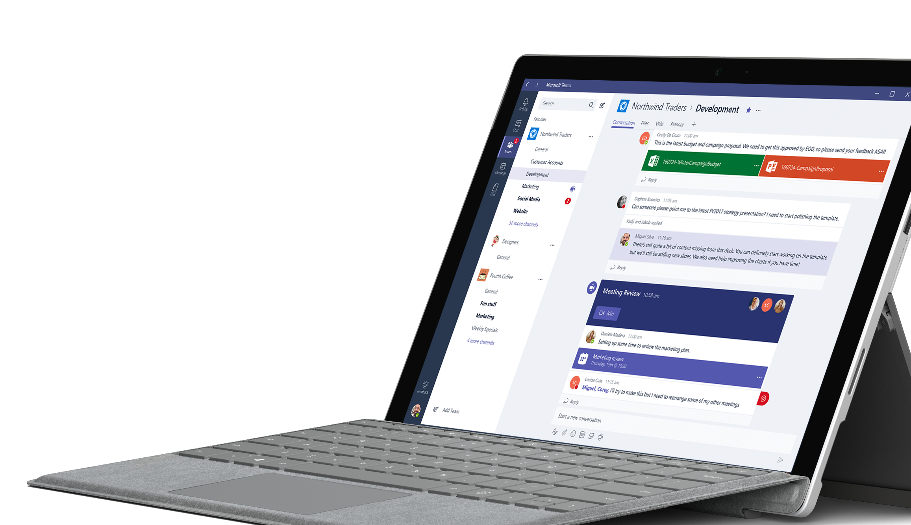
Demo
Notes:
This is the native desktop Windows client for Teams. We also provide a web client, a desktop client for Mac and native mobile clients for iOS, Android, Windows Phone.
Teams is offered at no additional charge to both its free and paid licenses of Office 365 in Education.
Let me walk you through our product from left to right.
On the left, we have the app bar where all the useful apps are pinned.
The first app on the top is activity feed, which keeps me updated with notifications from other people who want my attention in a conversation. This is also an extensibility point for us wherein you as a third party service can send notifications to your users in the same feed.
Going down, next we have chats - enables us to have private 1:1 and group discussions. Here is also where I can have private 1:1 conversations with bots, which is also open to third party integrations.
Below chat, we have Teams. This is where all the open communication and collaboration between teachers, students and staff happen.
Here, in this scenario I am a Graduate Teaching Assistant in the School of Business. I can see the different classes and teams I am a part of
Class Teams such as Entrepreneurship Seminar and Marketing Strategy
Staff teams such as School of Business
Each team consists of channels. A channel is a way to organize my conversations, content and tools in a team. In this case, I have used channels to organize different modules and topics in my curriculum for the class.
As a teacher, when I add students to the class, every student can see these channels, which makes it transparent for everyone to communicate in the classroom.
To the right, we can see the main canvas where we can see multi-threaded conversations happening inside this channel.
I have several ways to interact with a conversation, such as a quick thumbs-up (thumbs-up a message) or reply to acknowledge someone's message and I can also bring in GIFs, stickers, files and apps to the discussion to make it more fun, engaging and relevant.
As I scroll through, I can see several red indicators that give me quick visual cues to drive my attention to conversations important and relevant to me.
Along the top, we can see a set of pinned tabs that bring in relevant content and tools to the channel.
I can choose to add as many tabs as I'd like by simply clicking on the plus sign (click + sign) and choosing the app I would like to pin. This is one of our extensibility areas that allows you to bring in your full, rich canvas experience into the channel.
To show you an example of what one of the app looks like, we can see how Flipgrid has leveraged the full canvas of this channel. As we can see here, the teacher wants her students to record a video on what they think the lives of Native Americans in New York would be like.
I can interact with this tab just like I would in a browser and can also expand it (expand) to leverage the entire real estate of Teams so that the user can fully immerse in the app.
Furthermore, I can click on the conversation icon on the right to instantly start or continue a discussion thread around this tab.
This thread is persisted and can be found back in the conversation stream, from where anyone can look at this discussion and easily access the tab by clicking on the card.
Another way for an app to participate in a team discussion is through Polly. In this case, I want to treat my class to lunch and want them to vote on what they’d like to eat. I can invoke Polly to instantly create a poll, which I can interact with and see the result update in real time, while at the same time allow students to start a discussion around it.
Do you have any questions so far?

Slide 5







App Extensibility
Bots
Tabs
Help users get tasks done in conversations
Surface rich content within Teams
Extensible Platform
Build apps with a rich set of capabilities to enable these higher performing teams and reach your users in their chats, channels, notifications, and personal workspace.
Drive engagement by submitting your app to the Office Store.
Connectors
Activity Feed
Post rich updates to channels
Engage users via feed notifications
Actionable Messaging
Compose Extensions
Add rich interaction to your connector cards
Allow users to query and share rich cards in conversations

Slide 6
Contoso in Microsoft Teams
Notes:
Let's now take a look at specific examples on how a hypothetical education company, Contoso, would leverage these extensibility points inside Microsoft Teams.
Do you have any questions?

Slide 7
Discover Apps

Slide 8
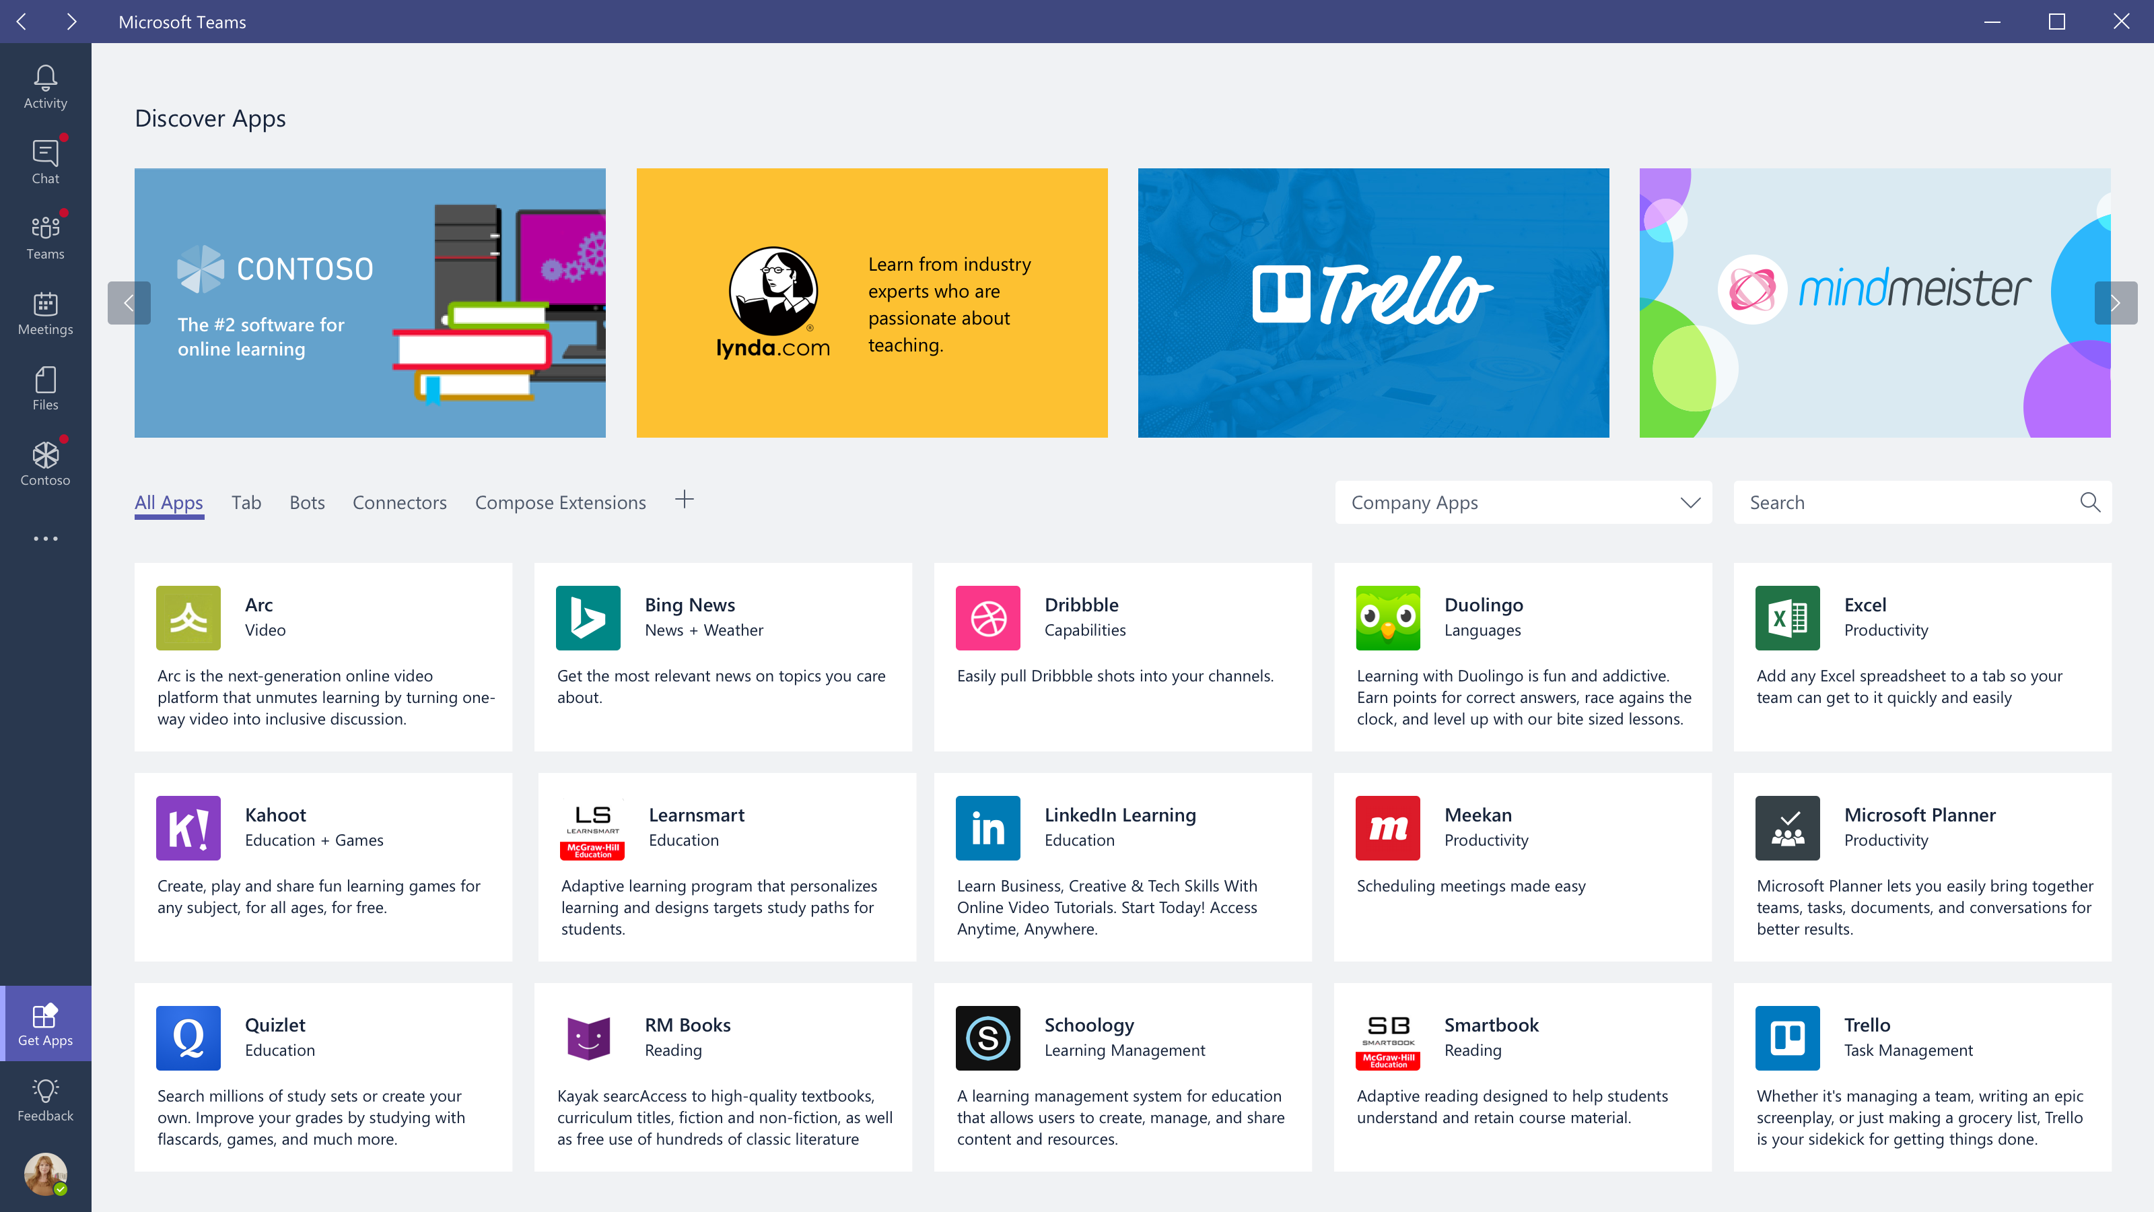
Notes:
This is the app gallery where all the apps are served and discovered
When you implement one or more of these integration points, you are building an app for Teams.
A user can click on any of these apps to enable it for the entire team.
Now let's take a look at how Contoso, the #2 software for online learning, implements each of our integration points.

Slide 9
Tabs

Slide 10
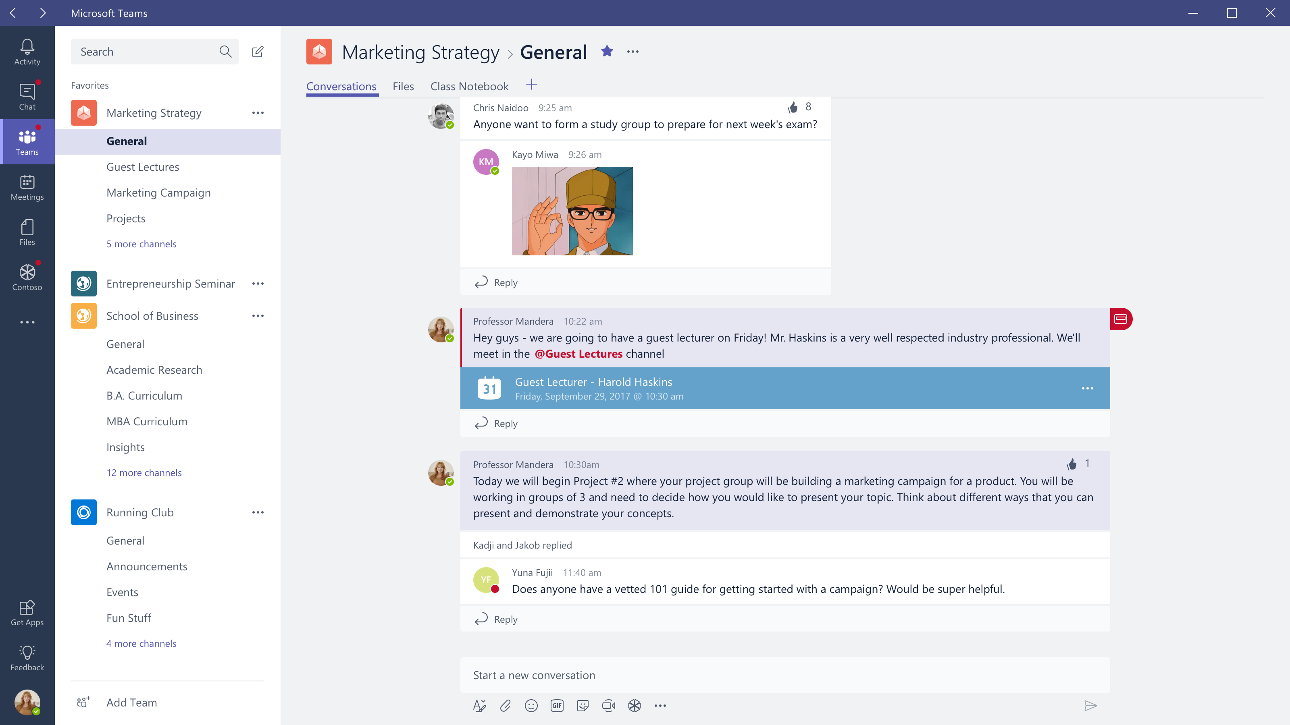

Slide 11
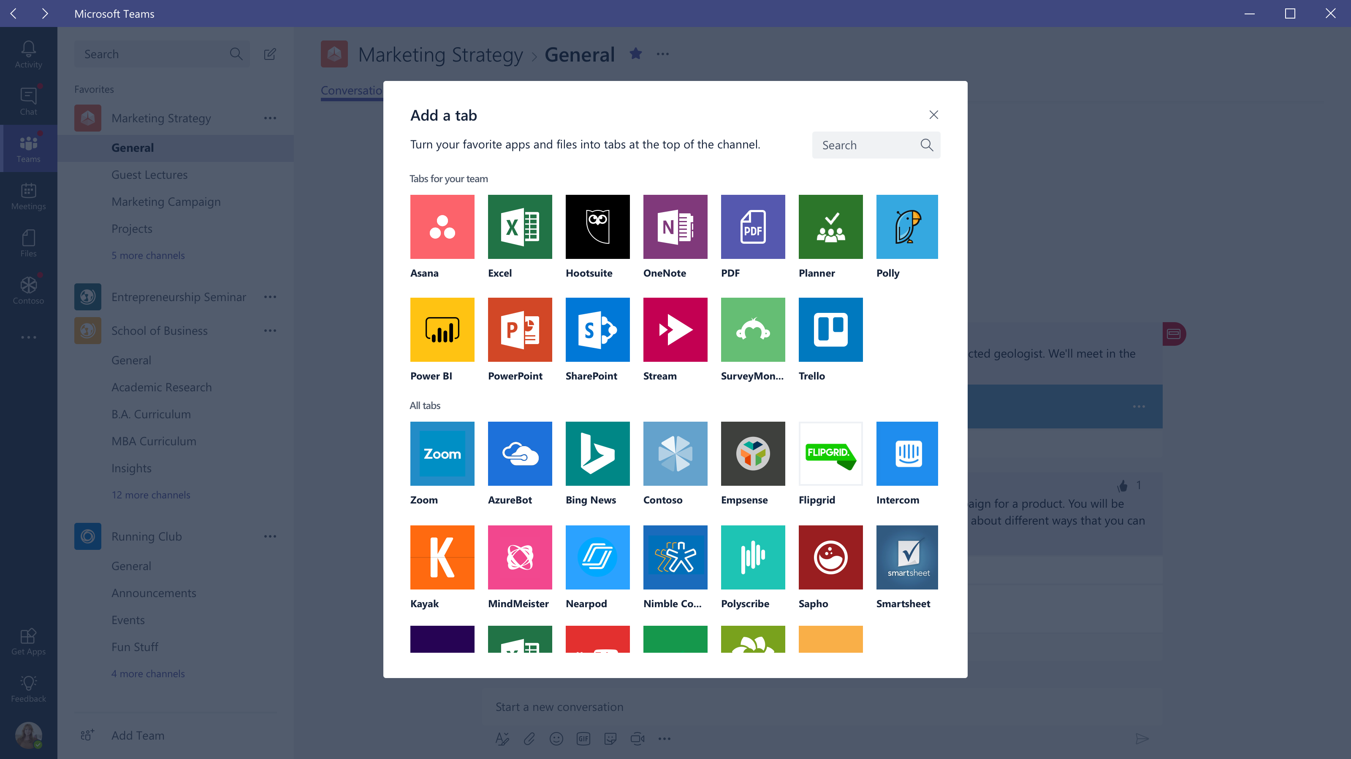

Slide 12
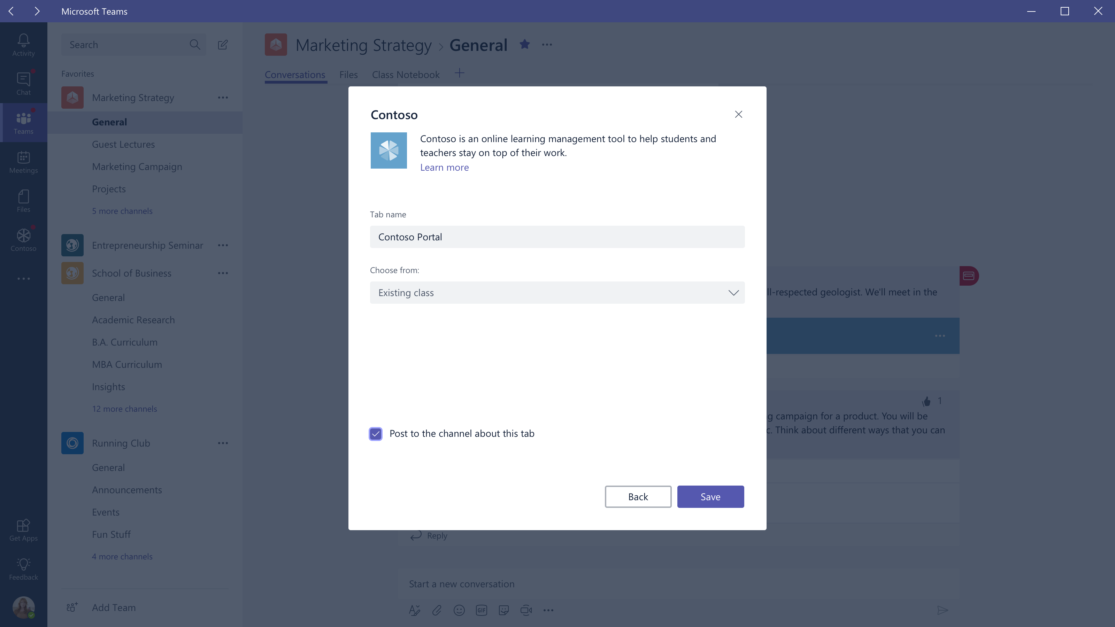

Slide 13
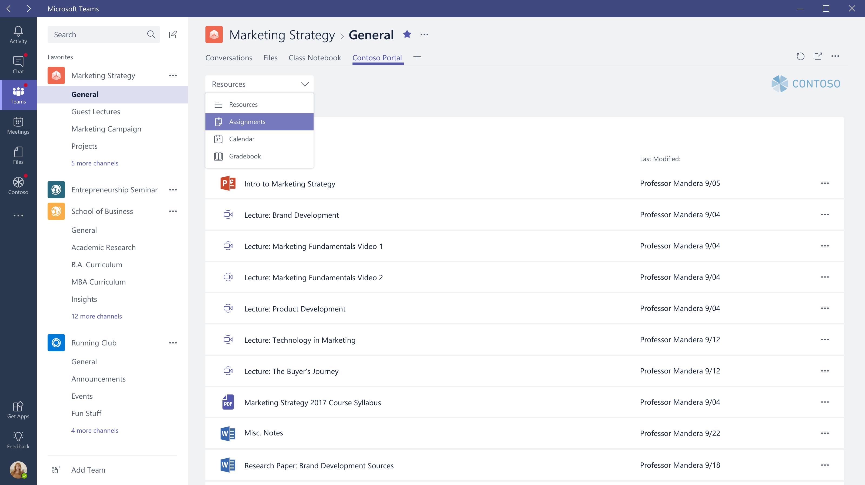

Slide 14
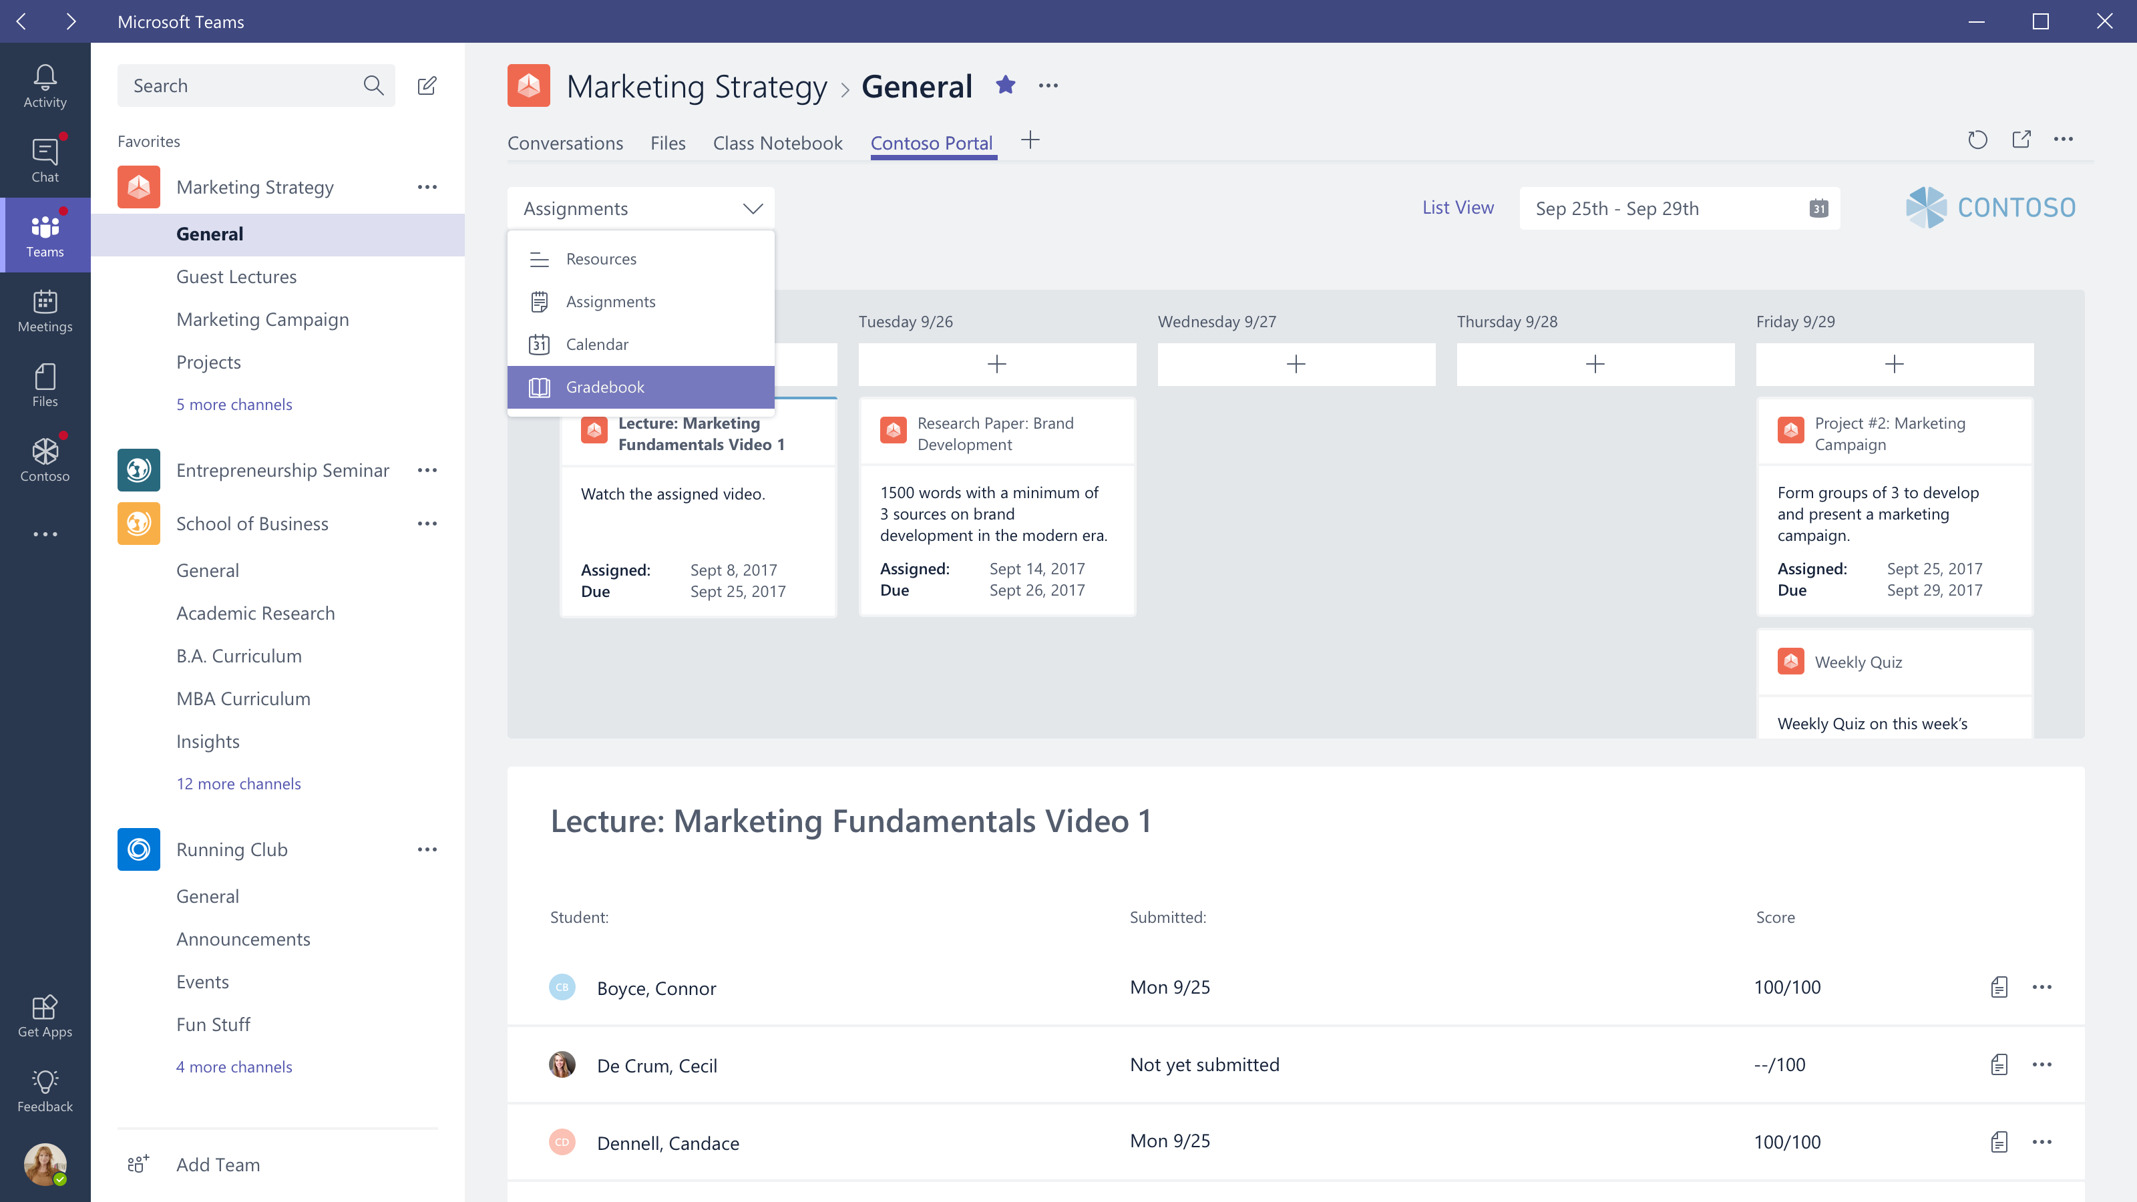

Slide 15
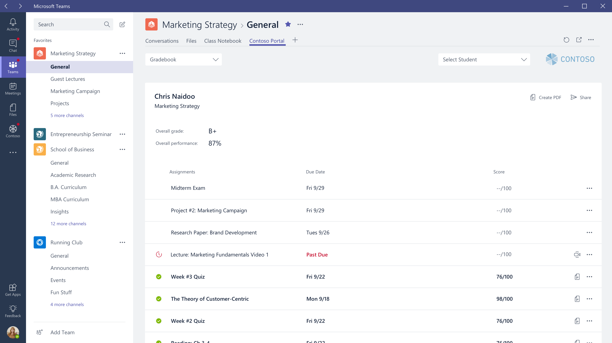

Slide 16
Bots

Slide 17
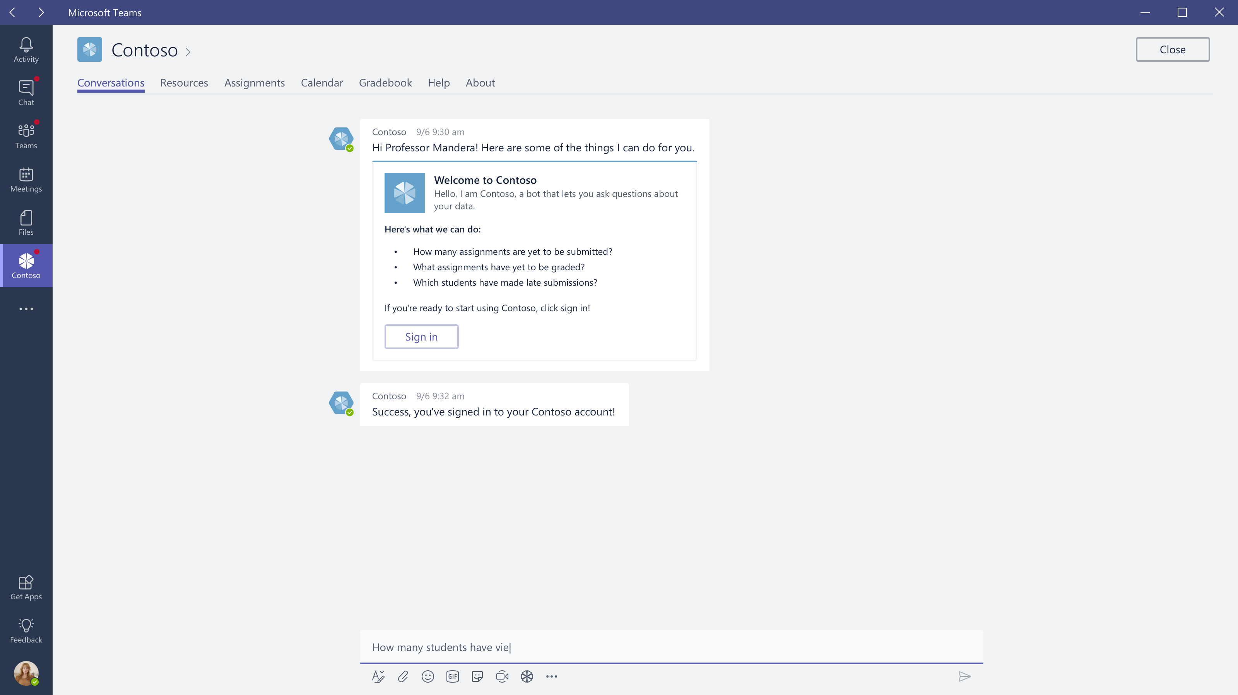

Slide 18
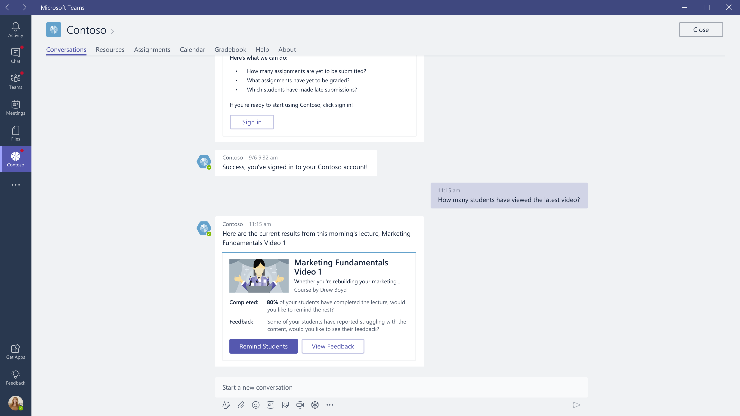

Slide 19
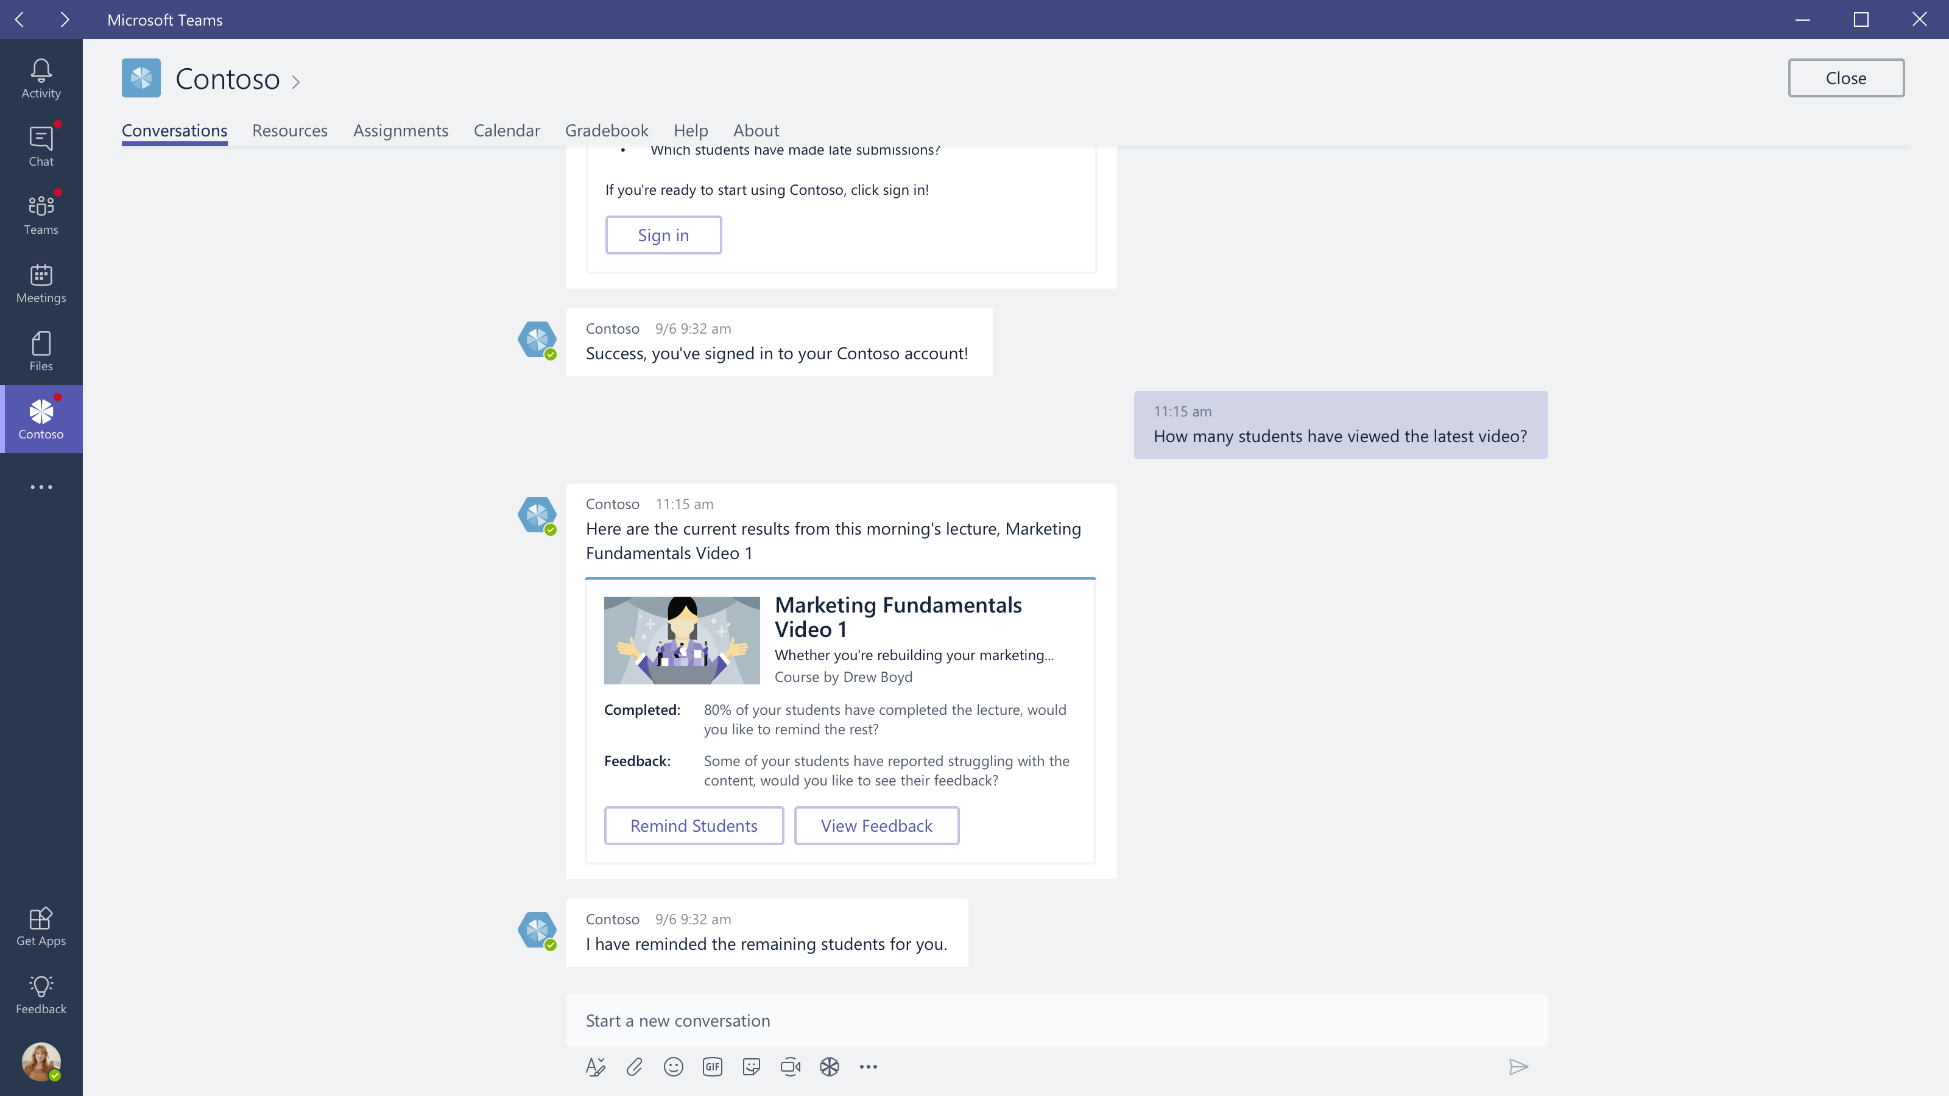

Slide 20
Activity Feed

Slide 21
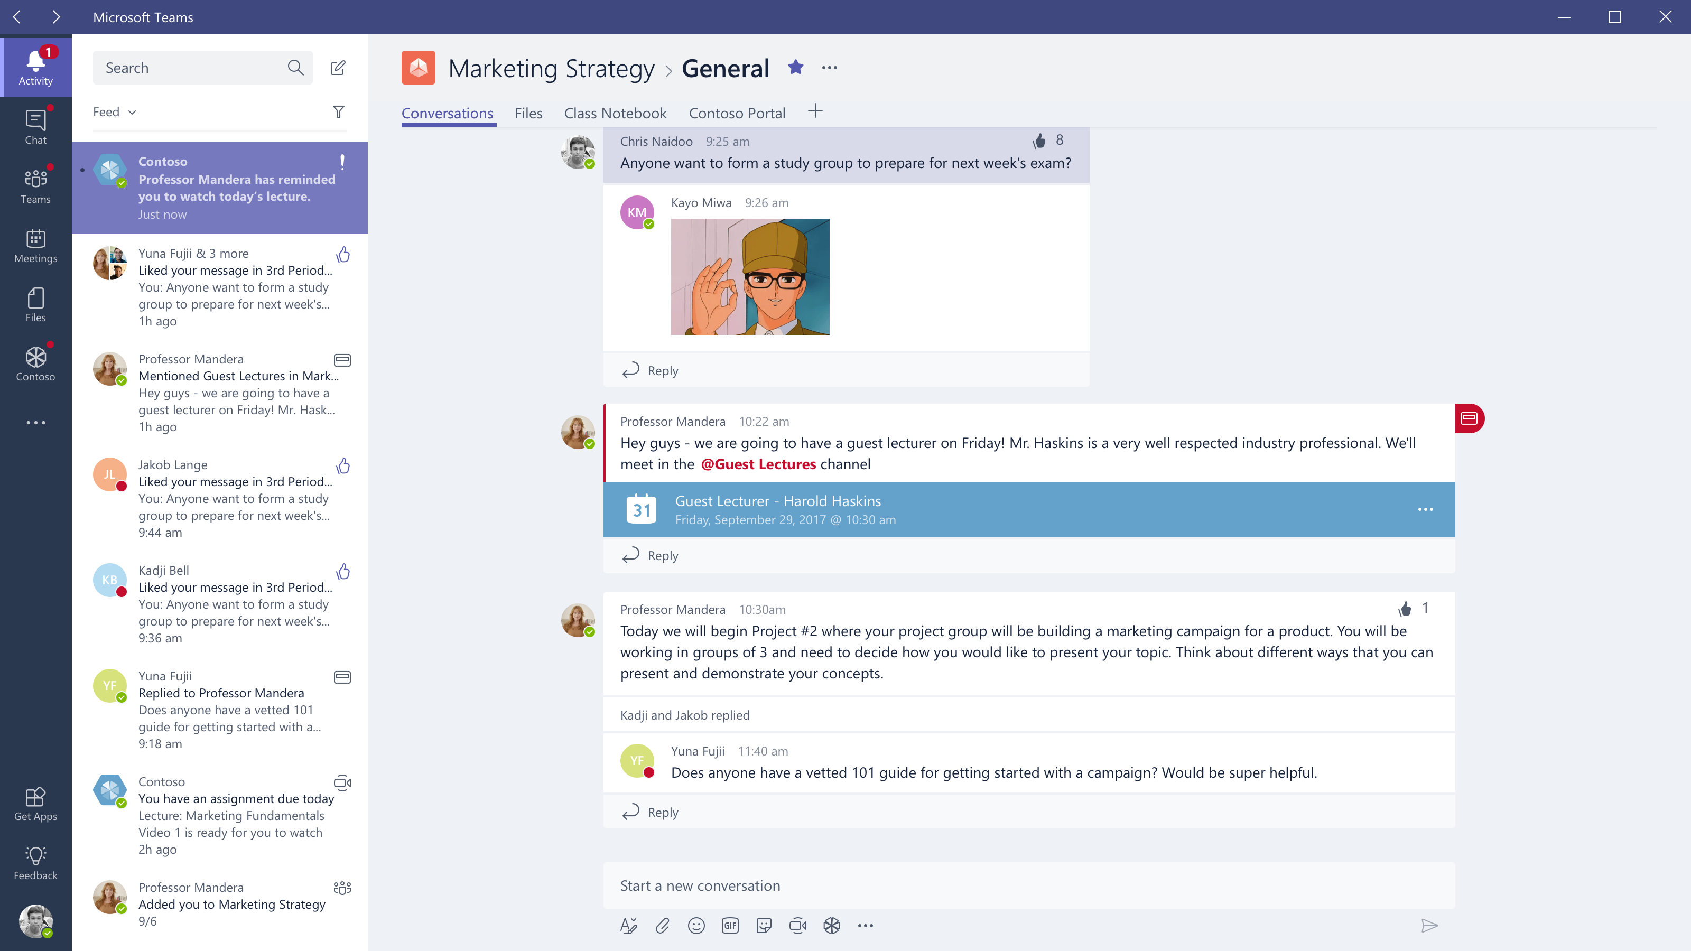

Slide 22
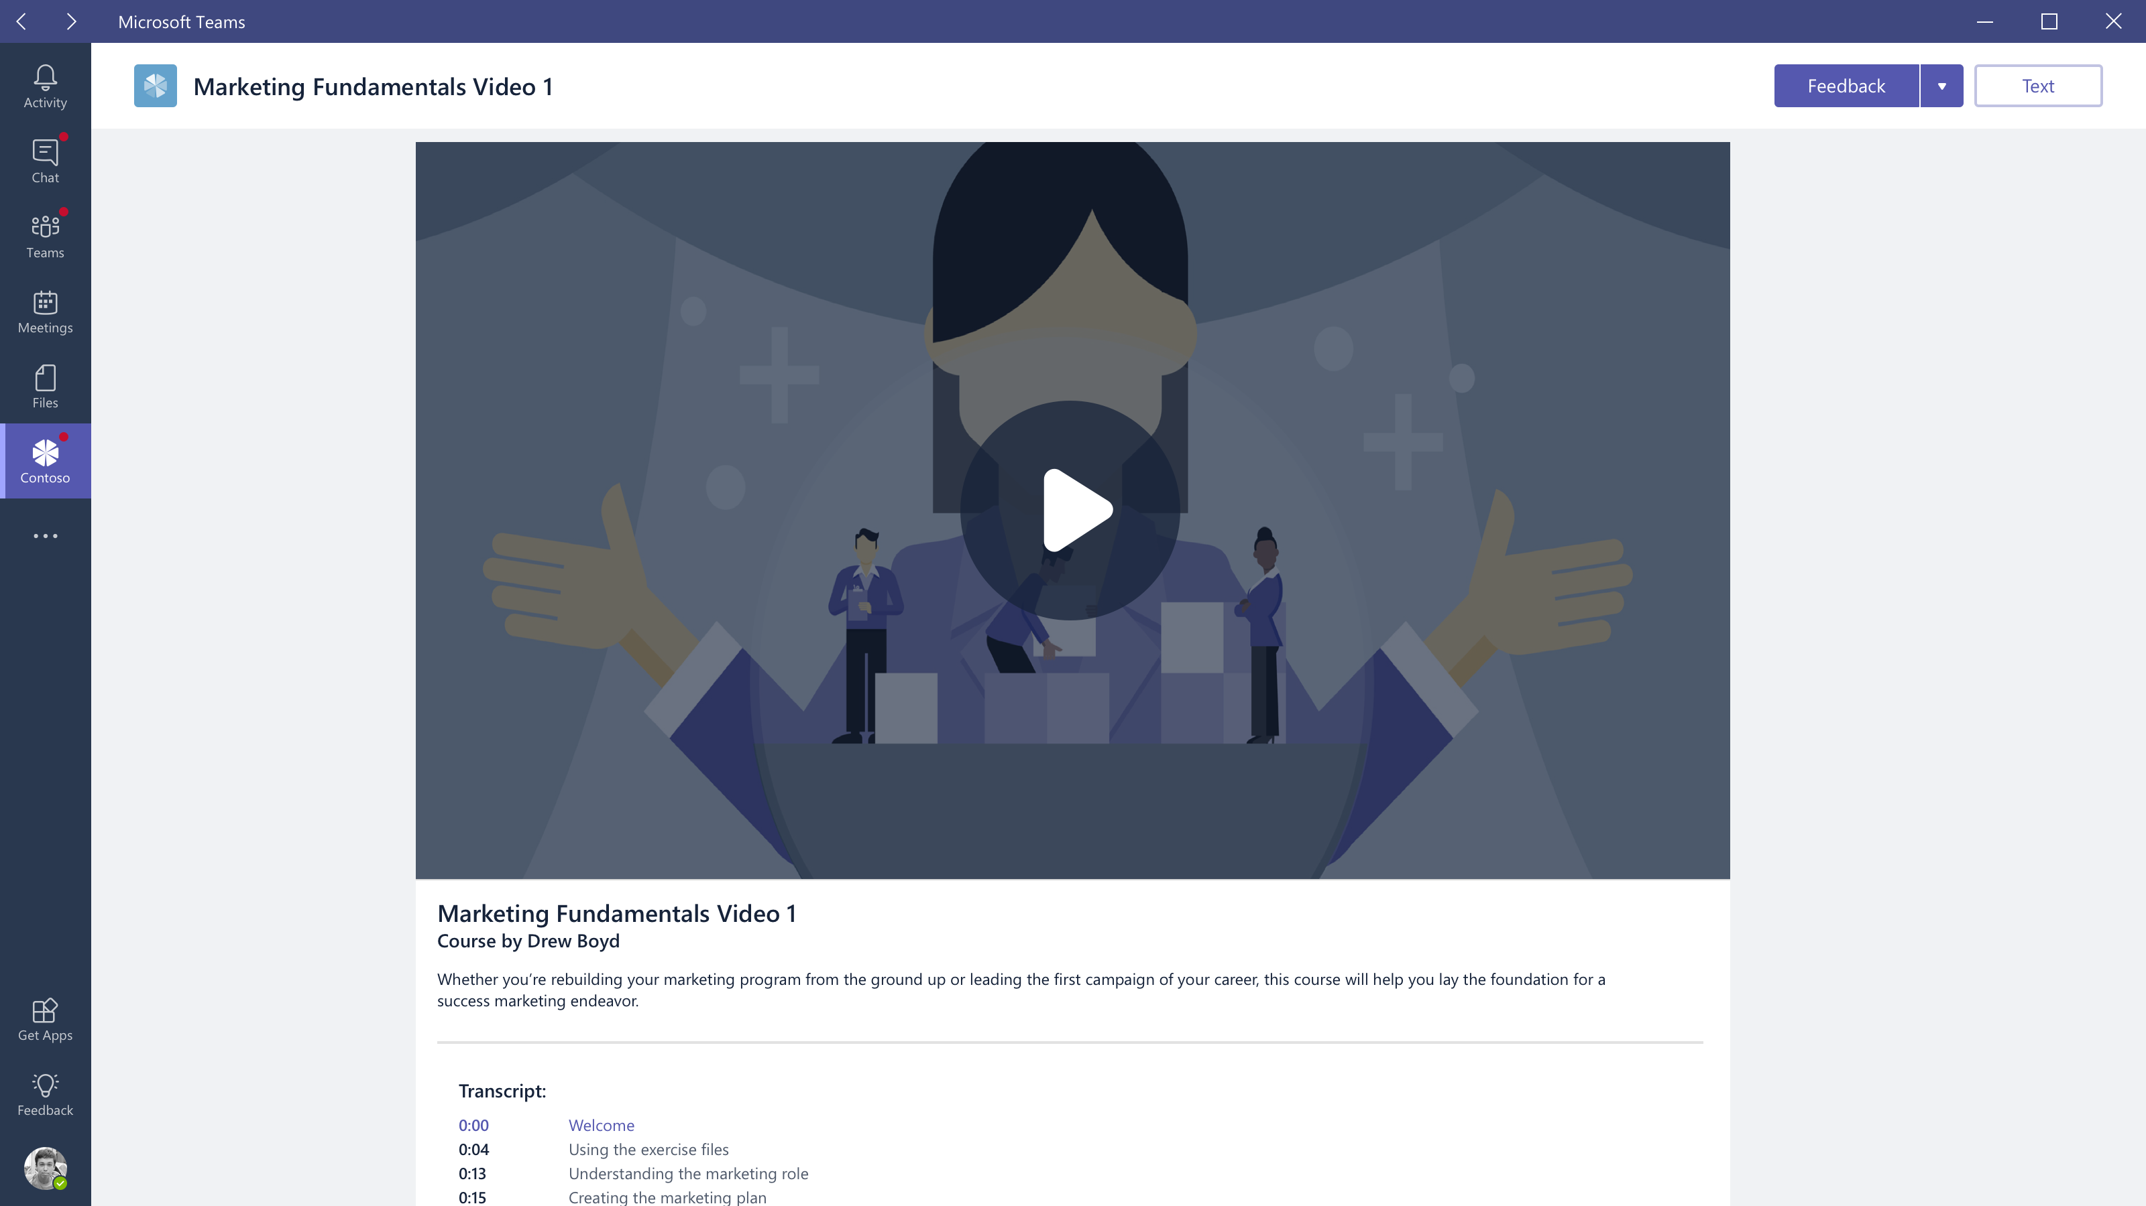

Slide 23
Actionable Messages

Slide 24
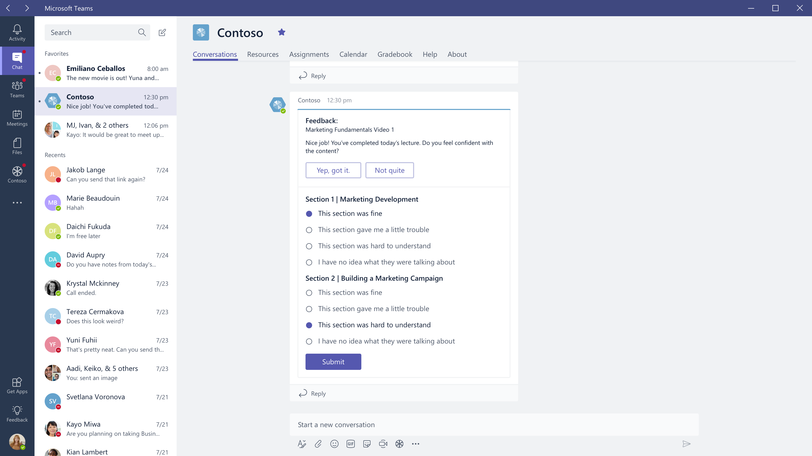

Slide 25
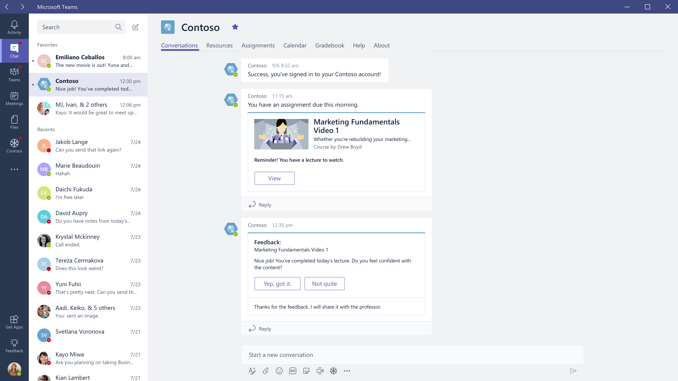

Slide 26
Connectors

Slide 27
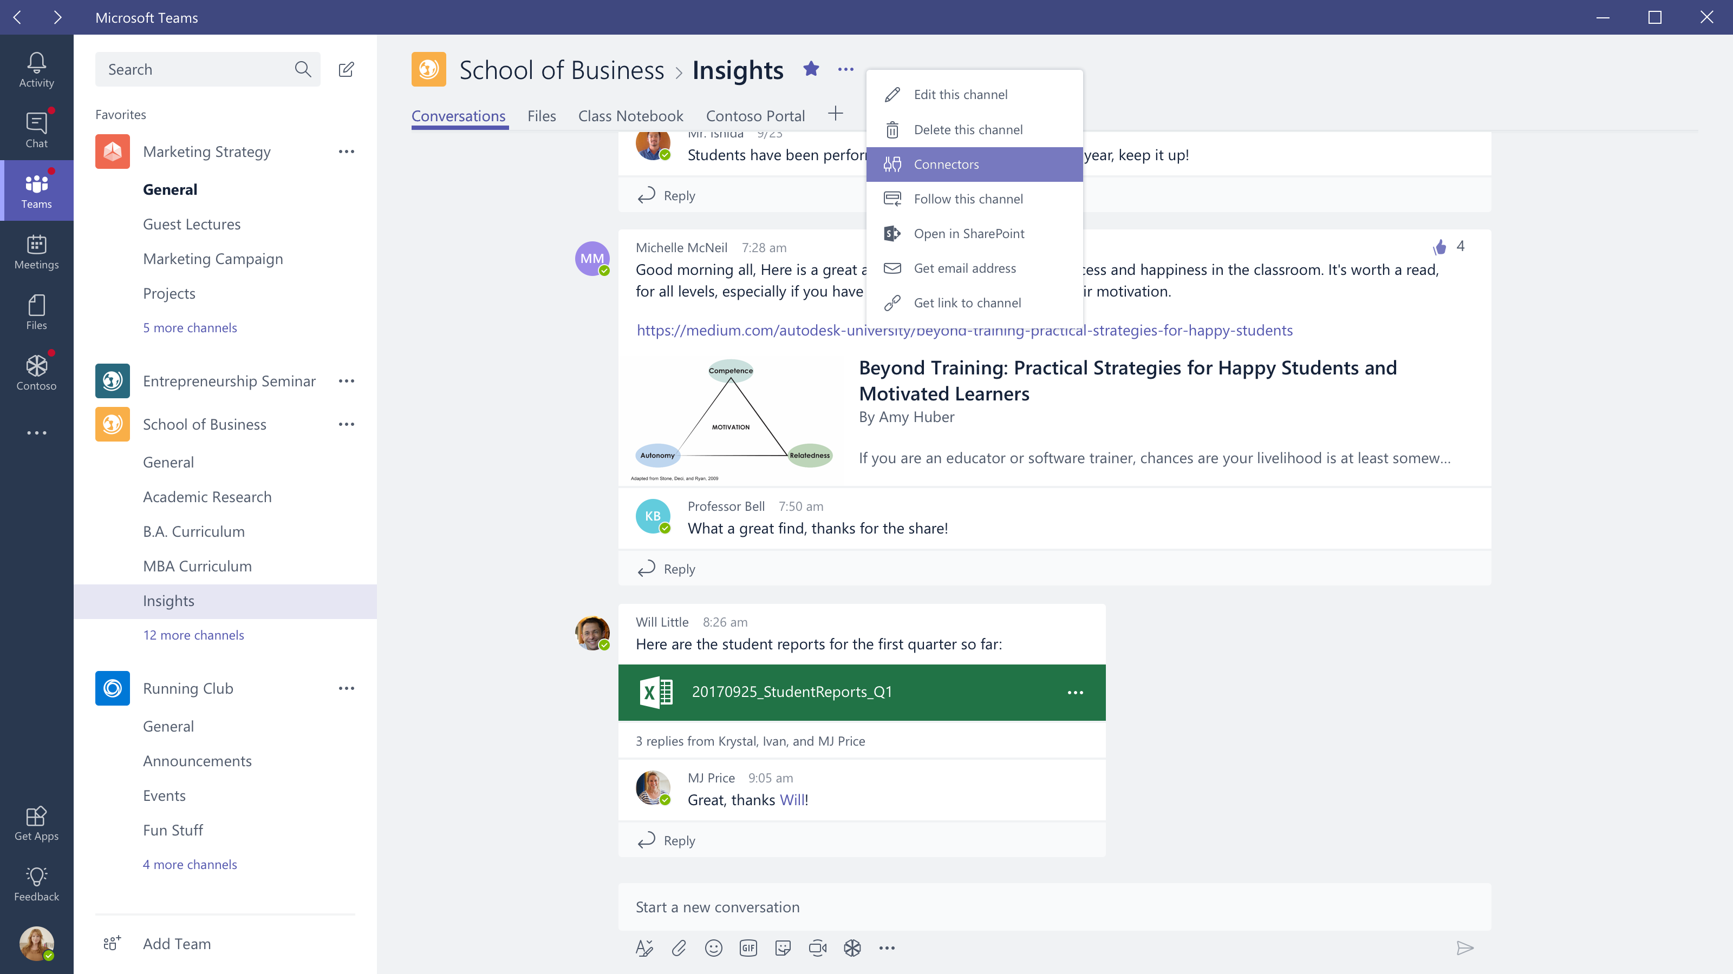

Slide 28
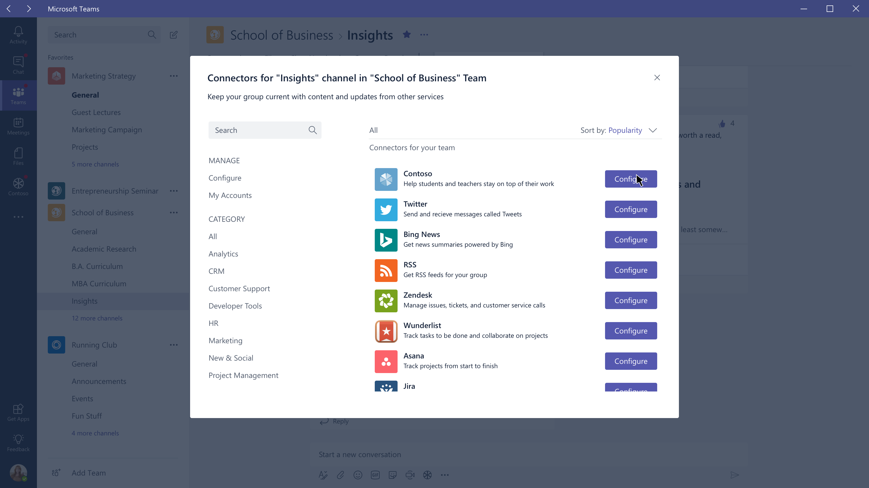

Slide 29
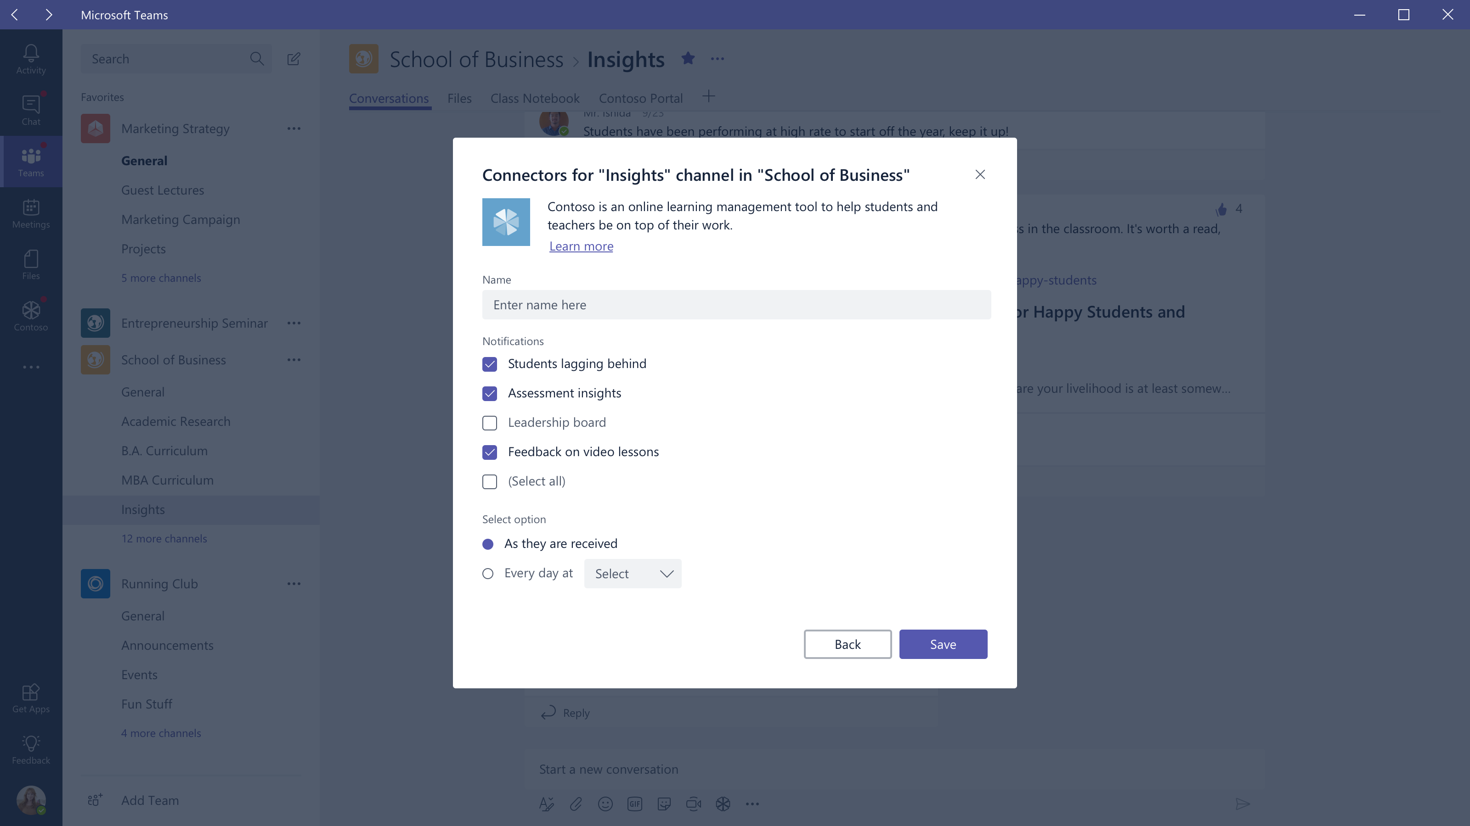

Slide 30
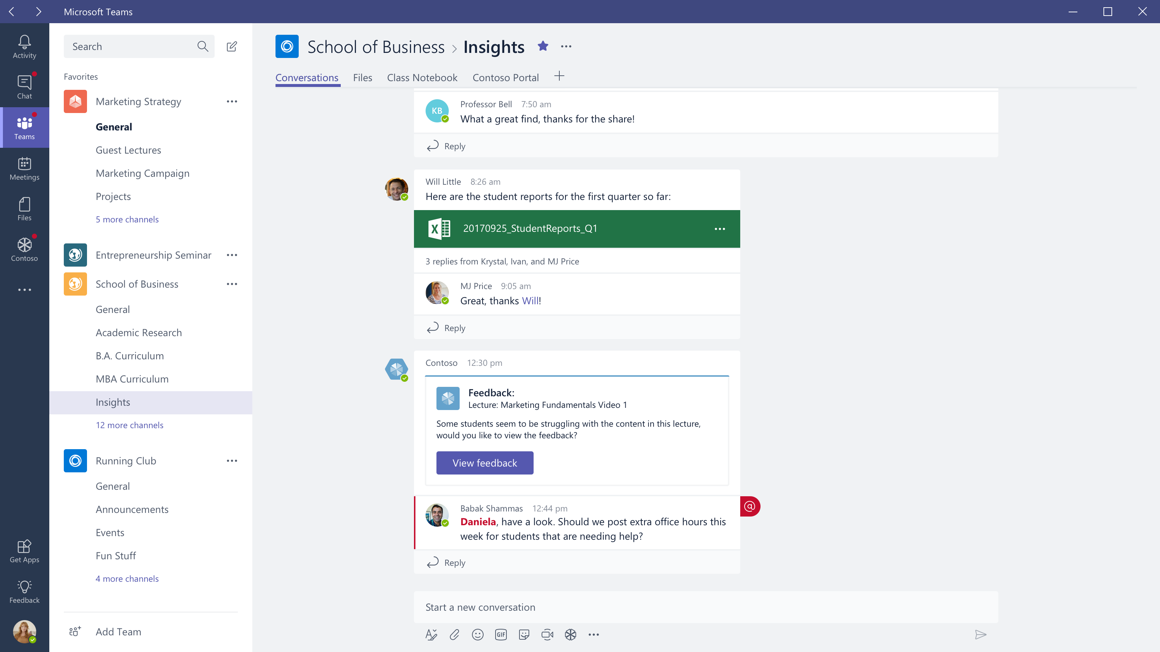

Slide 31
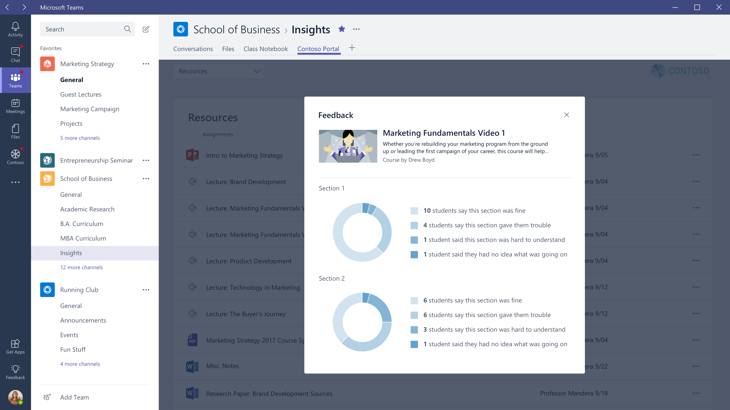

Slide 32
Compose Extensions

Slide 33



Slide 34


Slide 35
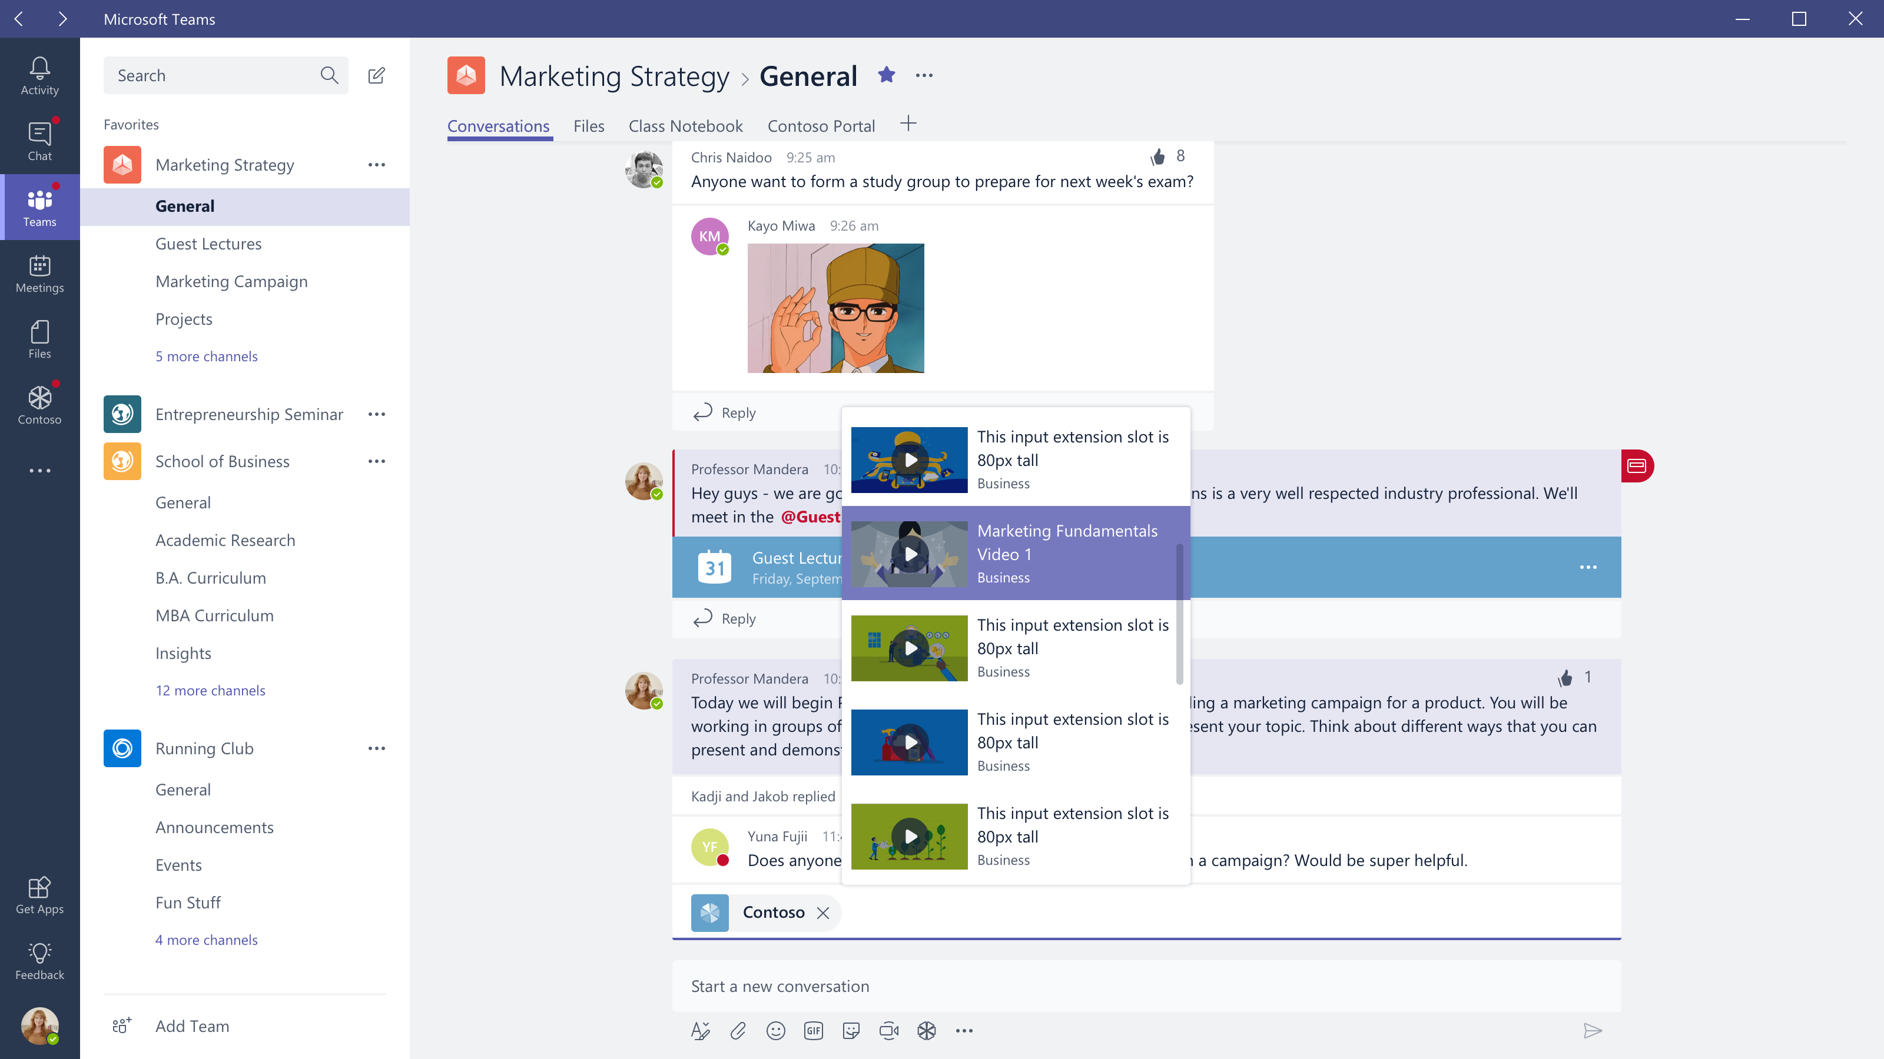

Slide 36
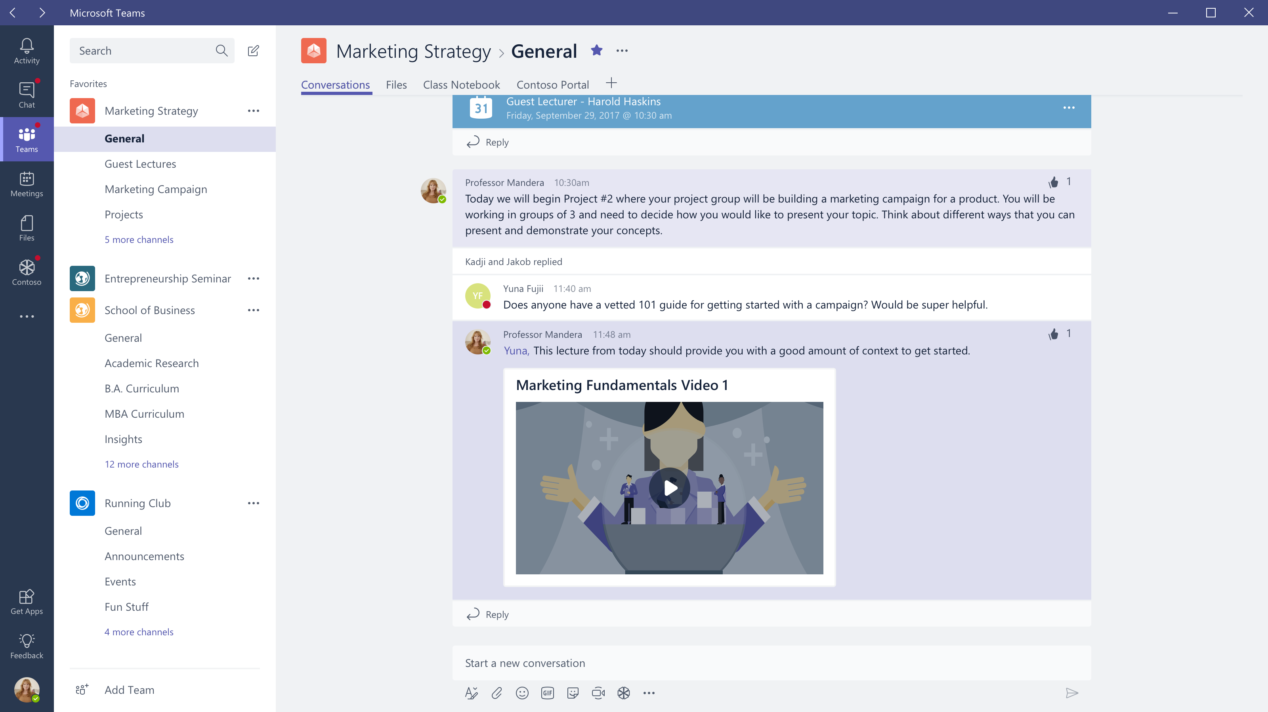

Slide 37
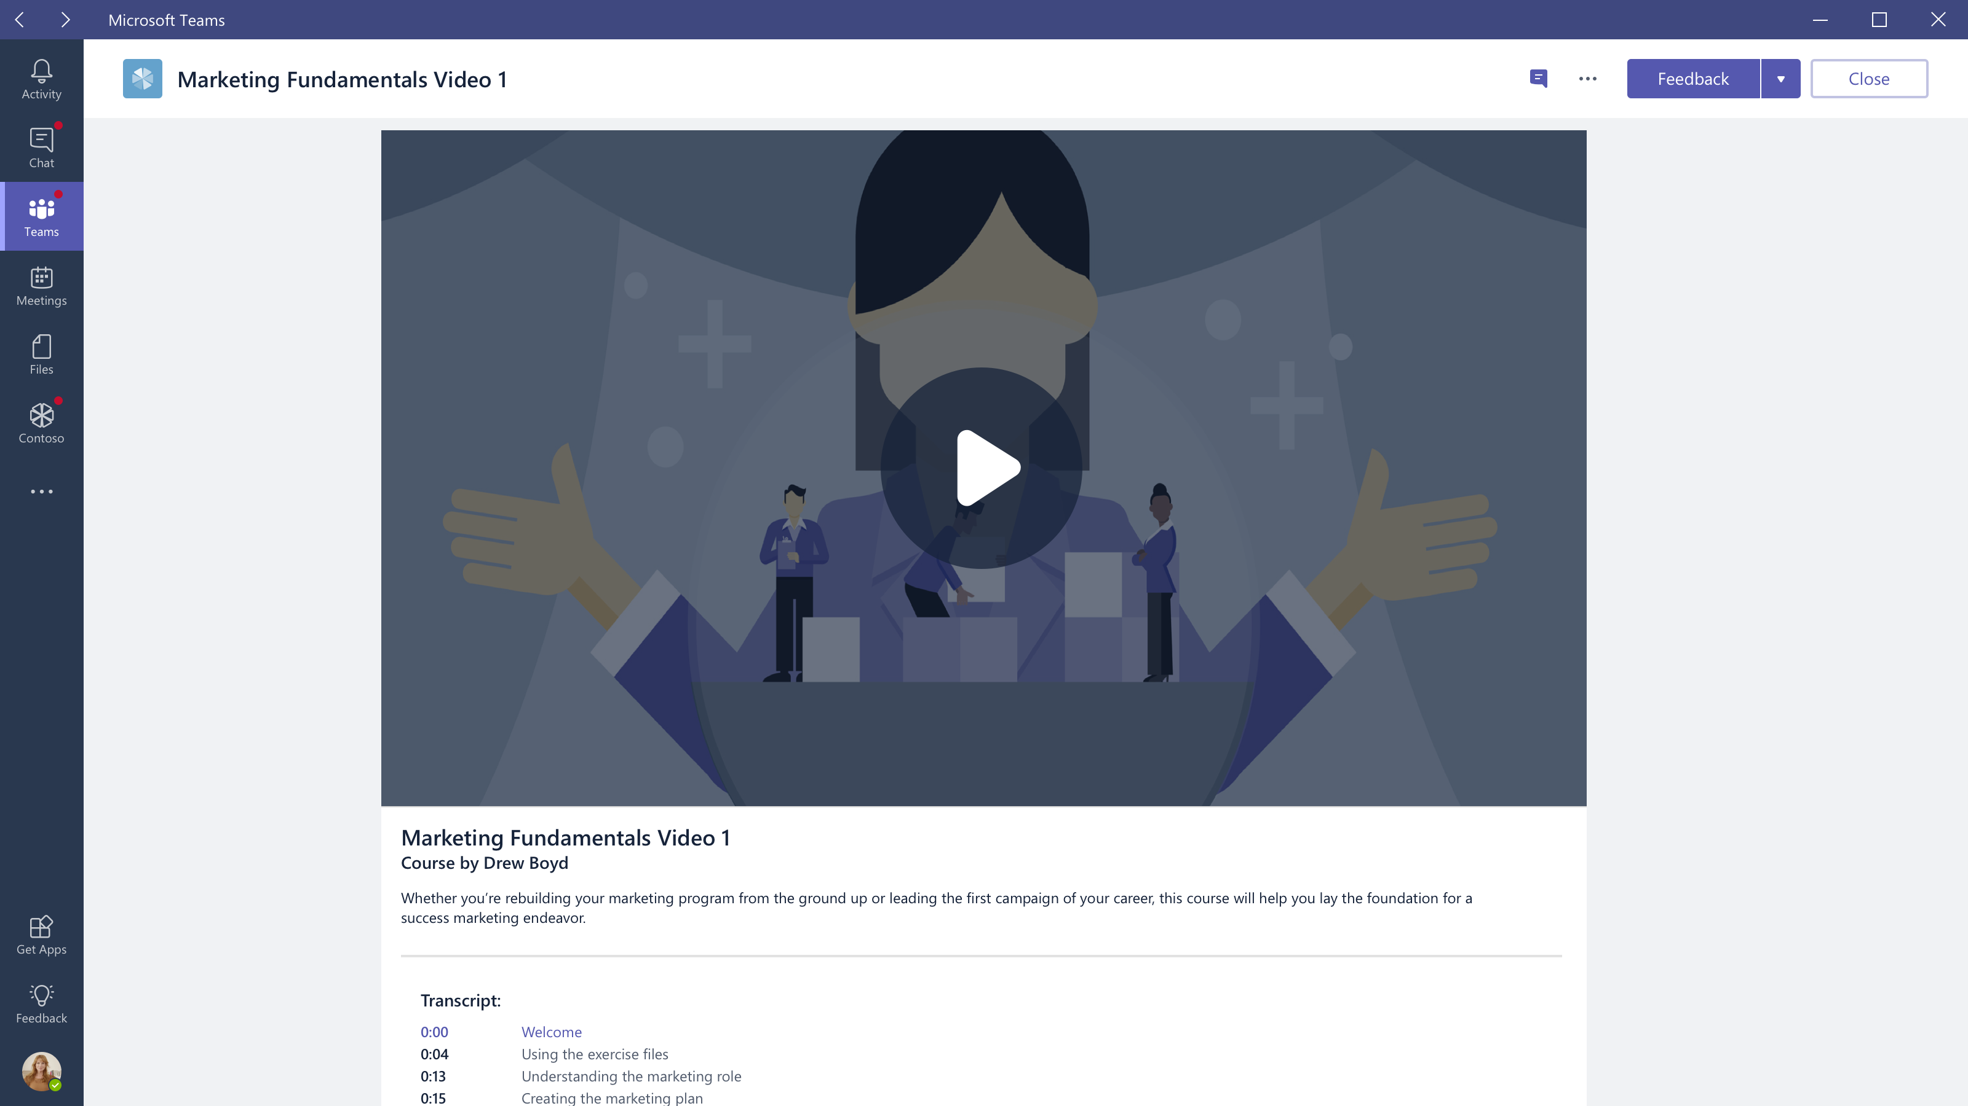

Slide 38
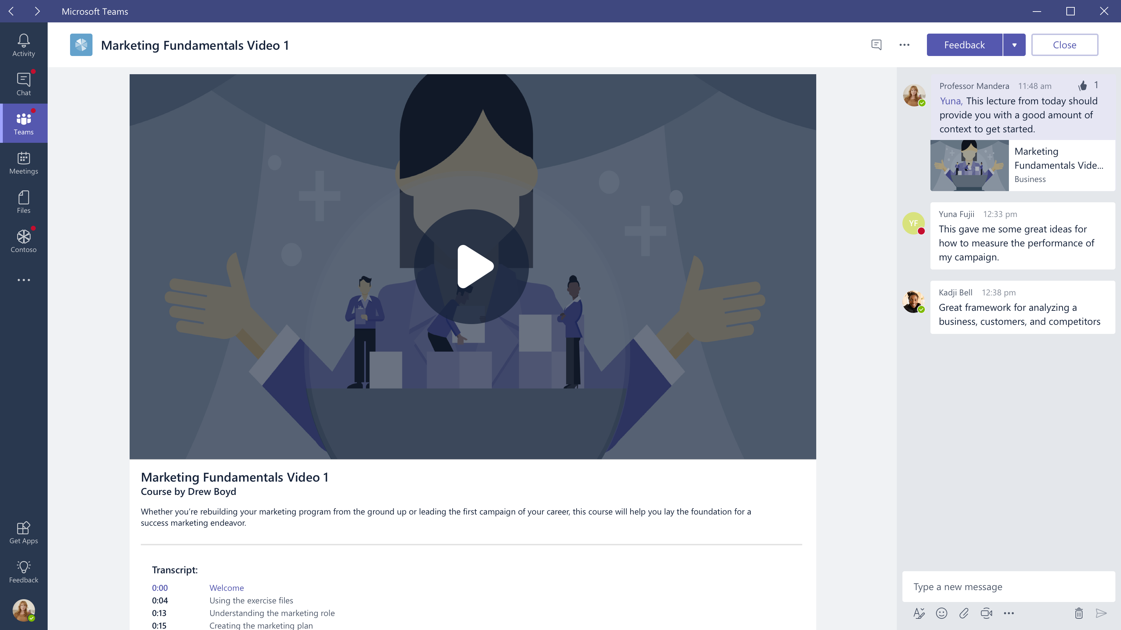

Slide 39
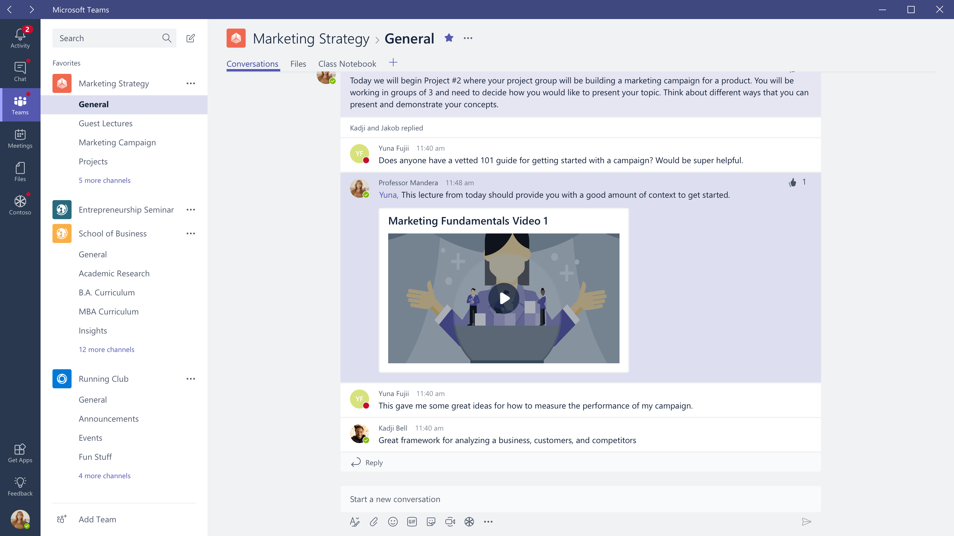
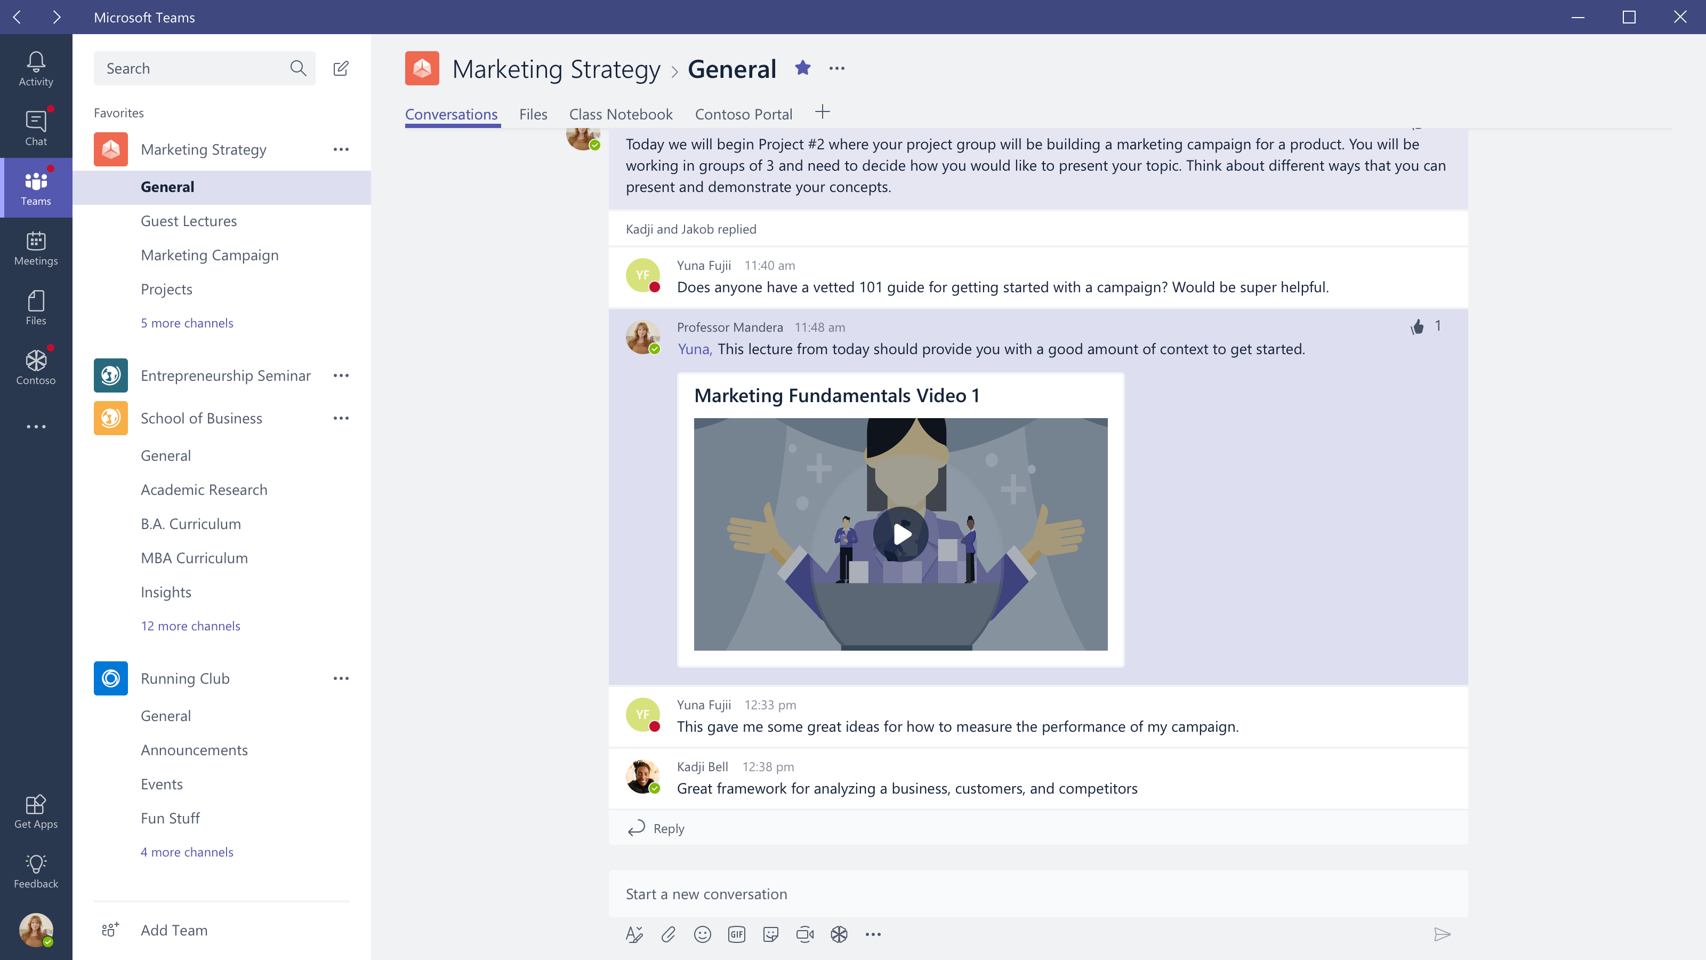

Slide 40
Mobile

Slide 41
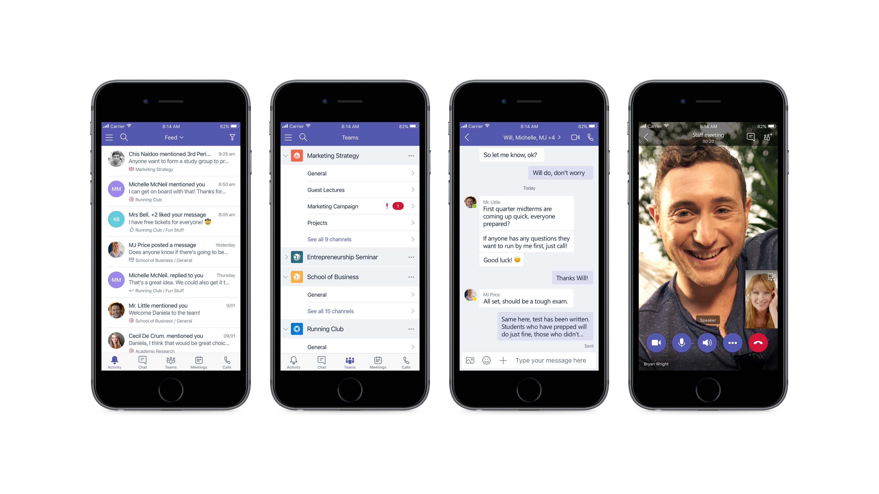

Slide 42
Microsoft’s global commitment to education: fueling the collaborative classroom.
There are 100 million monthly active users of Office 365.
Teachers in 146 countries around the world are able to use Office 365 for Education free of charge.
A total of 15 million student notebooks have been created in OneNote at a rate of approximately 45,000 new student notebooks each day.
Free accessibility tools with Office 365 for Education, like Learning Tools immersive reader in OneNote, have increased students’ reading speed and comprehension.
More than 500,000 schools around the world are currently using Skype in the classroom and during our annual Skype-a-thon, classes traveled more than 10 million virtual miles in 2 days.

Slide 43
Next Steps
Check out our sample app
Design Guidelines
Developer Documentation
Office 365 Dev Program
Start developing with a step-by-step tutorial of the sample app.
Make great Teams apps by using the design guidelines created by our team of experts.
Reference the Teams developer documentation as you begin to build your teams experiences.
Get more information on developing for office as well as a free developer test tenant so you can start building today.

Slide 44

Thank you!

Slide 45




Global Reach

181
150
+
Markets
Integrations
100M
+
25
125k
Languages
Organizations
Office 365 commercial monthly active users

